Slide 1
Drugs, Side Effects and Medical Condition arrow_drop_up
Exploratory Data Analysis & Visualization using Python
Domain: Healthcare Analytics / Pharmacovigilance
Tools: Python, Pandas, Matplotlib, Seaborn
Dataset: Drugs.com Side Effects Dataset
Prepared by : Gayatri Raghunath Kulkarni
UNID: UMID05112569400

Slide 2
Project Objective
Goal of the Project
The objective of this project is to analyze:
Drugs used for different medical conditions
Common side effects associated with drugs
Drug safety indicators (pregnancy category, CSA, alcohol interaction)
User feedback through ratings and reviews
This helps in identifying patterns useful for healthcare decision-making.

Slide 3
Dataset Overview
Dataset Information
Source: Drugs.com
Total Records: 2931 drugs
Total Features: 17 columns
Key Columns:
Drug Name
Medical Condition
Side Effects
Drug Class
Rx/OTC Category
Rating & Reviews

Slide 4
Data Cleaning Process
Steps Performed
Checked missing values across all columns
Filled null values in:
  Side Effects
  Alcohol Interaction
  Ratings & Reviews
Converted rating and review columns into numeric format
Prepared dataset for analysis and visualization
Outcome: Dataset became clean and ready for EDA.

Slide 5
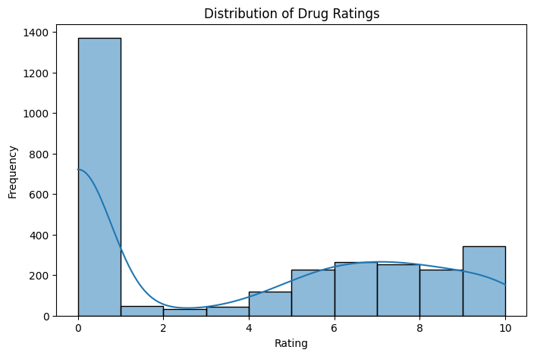
Rating Distribution Analysis
Visualization: Histogram of Drug Ratings
Most drug ratings fall between 6 and 8
Very few drugs have extremely low ratings
Ratings indicate overall user satisfaction and effectiveness
Insight: Majority of drugs are moderately to highly rated.

Slide 6
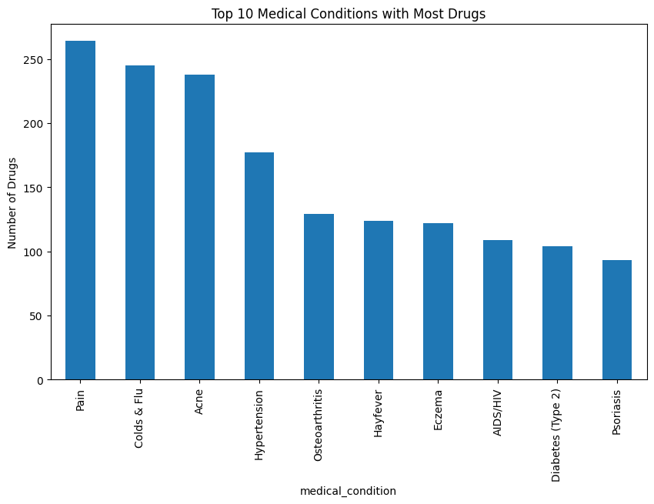
Top Medical Conditions Treated
Visualization: Bar Chart of Most Common Conditions
Top conditions with highest drug availability:
Pain
Colds & Flu
Acne
Hypertension
Osteoarthritis
Insight: Common chronic and lifestyle diseases dominate the dataset.

Slide 7
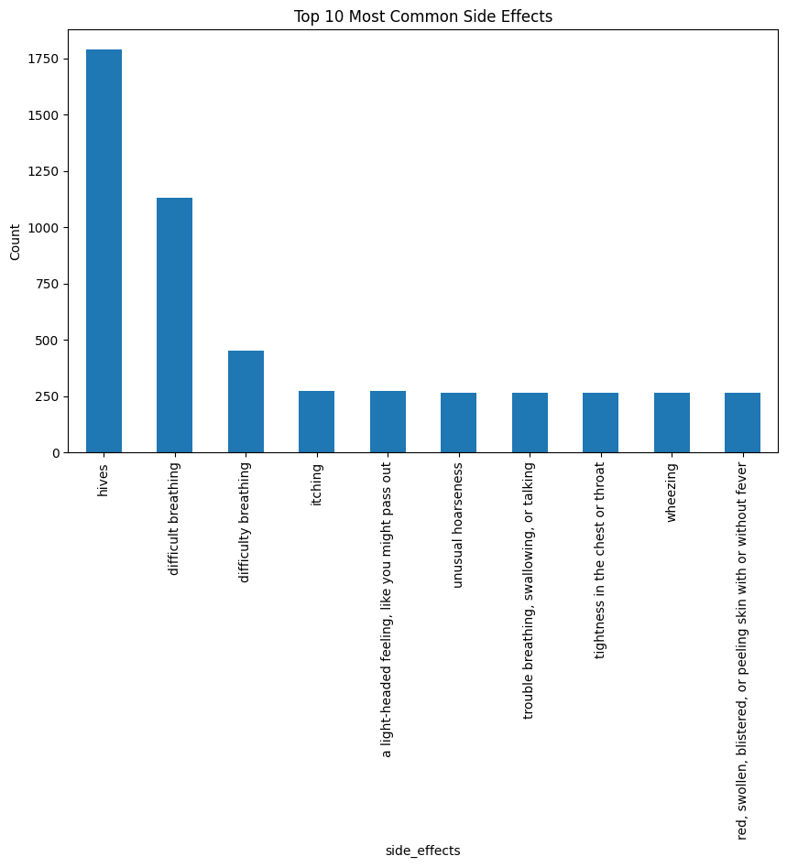
Side Effects Frequency Analysis
Visualization: Most Common Side Effects
Top reported side effects include:
Hives
Difficulty breathing
Itching
Skin rash
Swelling
Insight: Allergic reactions are among the most frequent adverse effects.

Slide 8
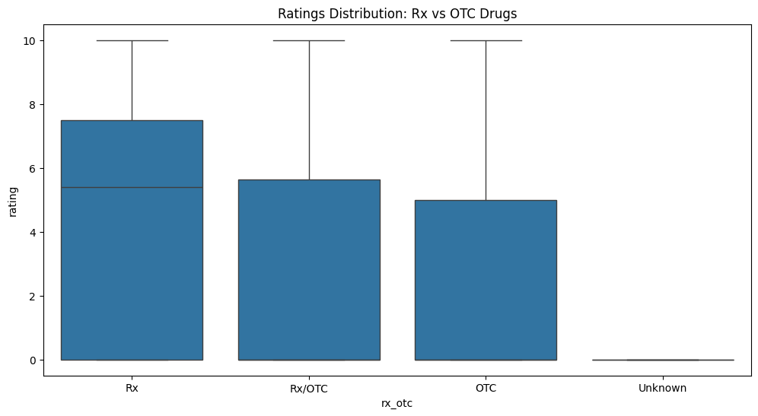
Rx vs OTC Drug Category
Visualization: Prescription vs Over-the-Counter Distribution
Majority of drugs are Prescription (Rx)
OTC drugs form a smaller portion
Insight: Conditions like pain, hypertension, and cancer rely heavily on Rx drugs.

Slide 9
Drug Class & Safety Indicators
Analysis Covered
Drug class distribution (Antihistamines, Steroids, Antibiotics)
Pregnancy risk categories (A, B, C, D, X)
Controlled Substances Act (CSA schedules)
Alcohol interaction warnings
Insight: Safety indicators are crucial for patient-specific prescribing.

Slide 10
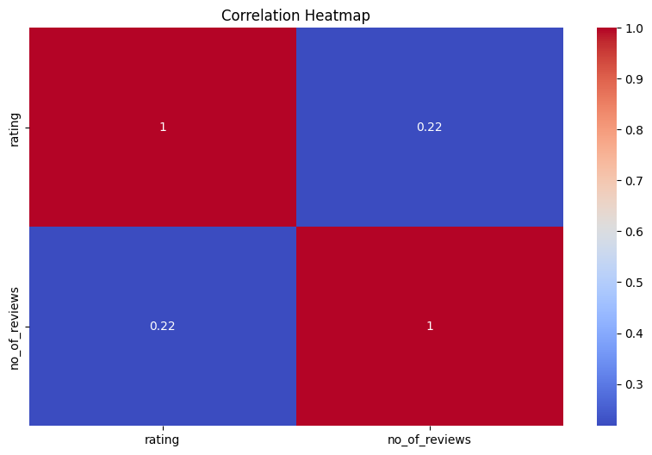
CORRLEATION HEATMAP

Slide 11
Conclusion & Future Scope
Conclusion
This project successfully explored relationships between:
Drugs
Medical conditions
Side effects
Ratings and safety categories
Future Enhancements
Predict drug ratings using Machine Learning
Side effect severity classification using NLP
Dashboard development using Power BI/Tableau
Drug recommendation system

